Slide 1
Knn python
Data Set: bankloan.csv

Slide 2
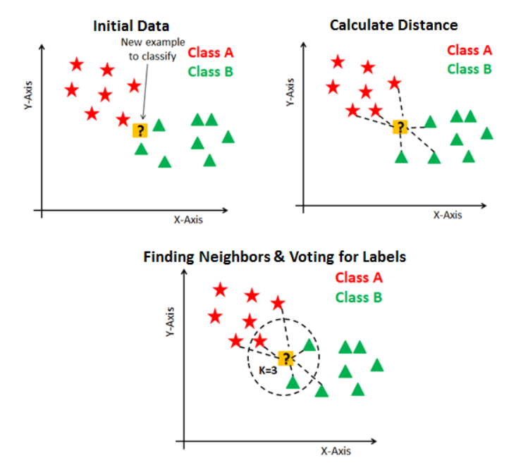
Nearest Neighbors

Slide 3
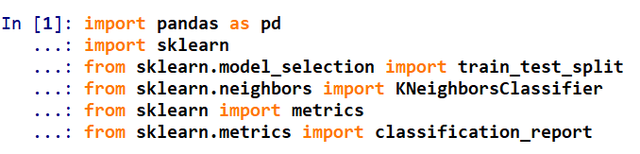
Libraries

Slide 4
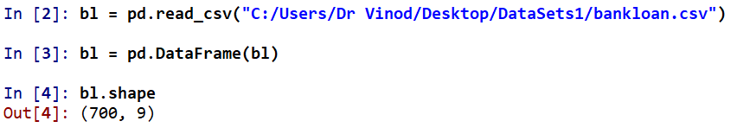
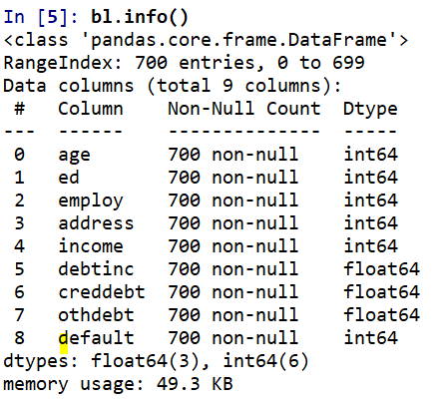
Data

Slide 5
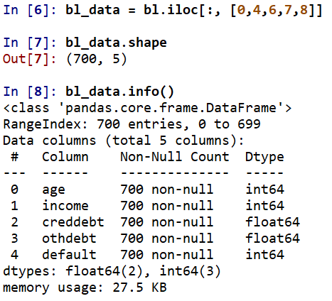
Sub set

Slide 6
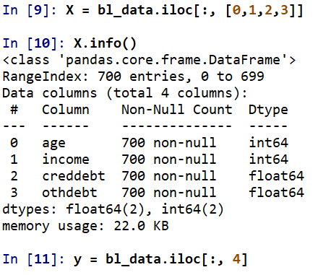
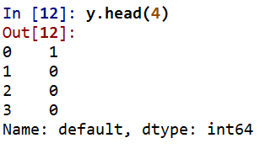
Predictors and Response Variable

Slide 7
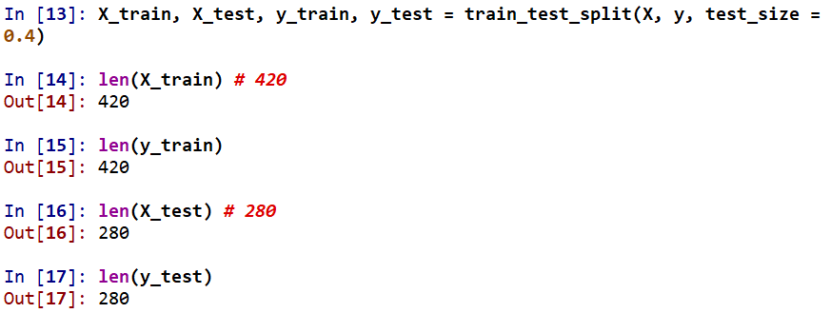
Predictors and Response Variable

Slide 8
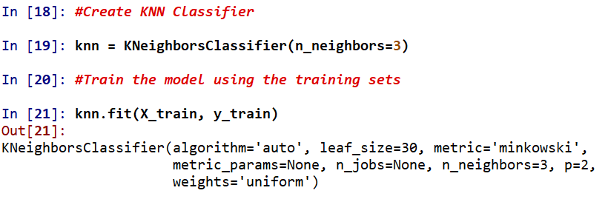
knn

Slide 9
Algorithm = ‘auto’ will find most appropriate algo from BallTree, KDTree & brute-force search
leaf_size = 30, is applicable if BallTree or KDTree is used

Slide 10
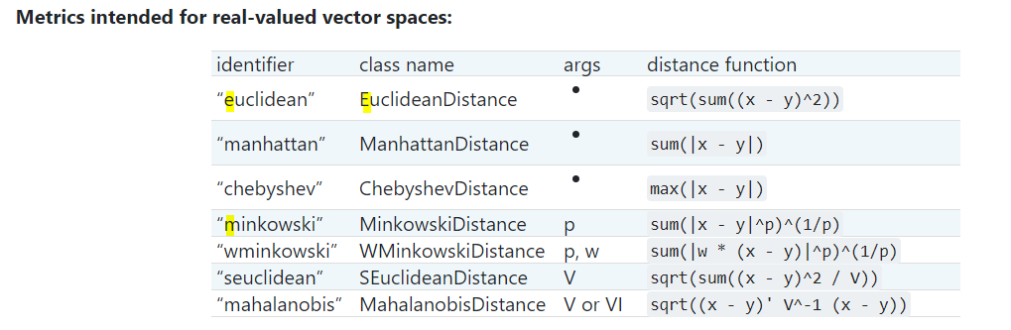

Slide 11
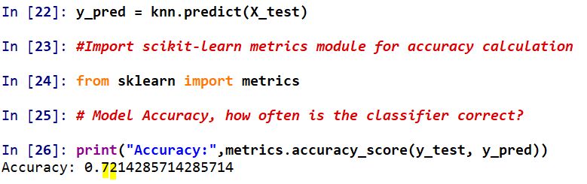
Accuracy

Slide 12
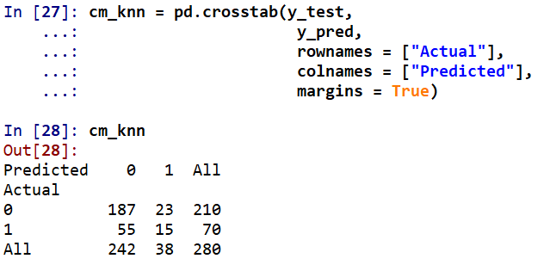
Cross Tab

Slide 13
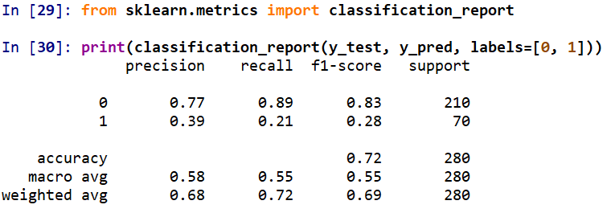
Classification Report

Slide 14




